Slide 1
Idlewild 5th Grade Parent Meeting
Feb. 15, 2022
Hosted by the 5th Grade Team, Mr. Collins, and Officer Leake

Slide 2
AGENDA
1. Student Baseball Cards
2. D.A.R.E
3. Logistics
4. Important Dates
5. Middle School Information
6. End of the Year 5th Grade Trip

Slide 3
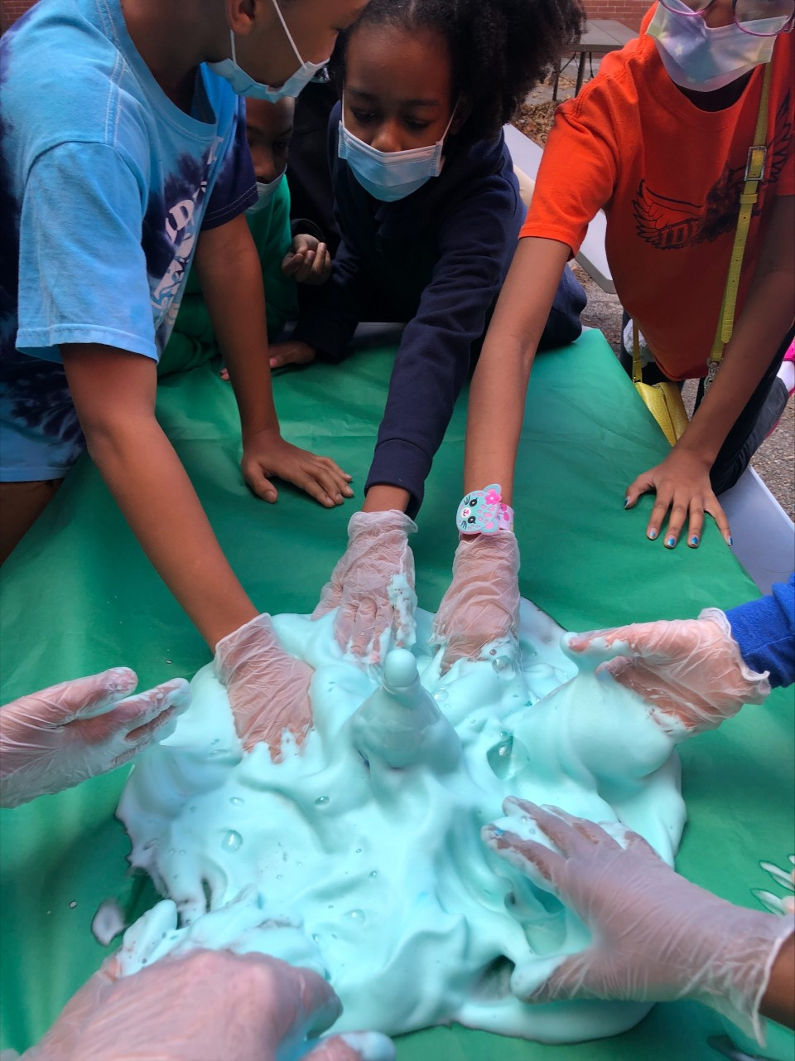
Student "Baseball Cards"

Slide 4
DARE

Slide 5
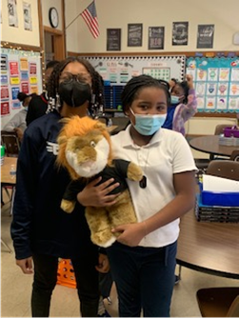
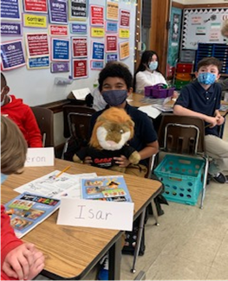
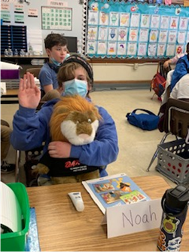
DARE

Slide 6
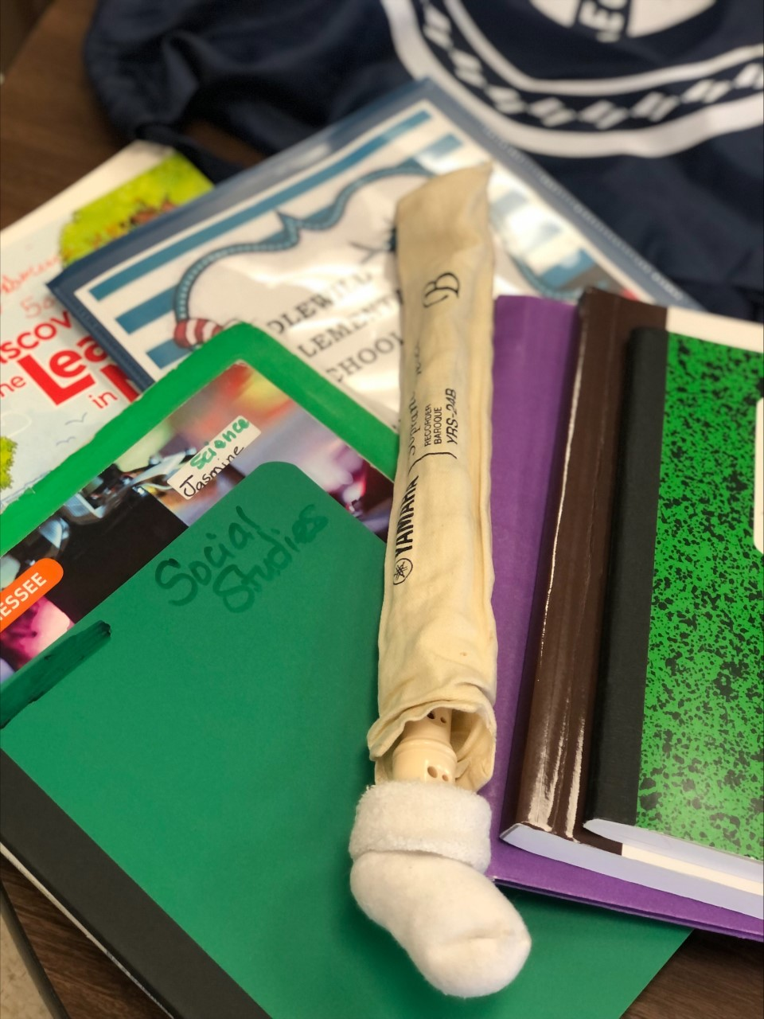
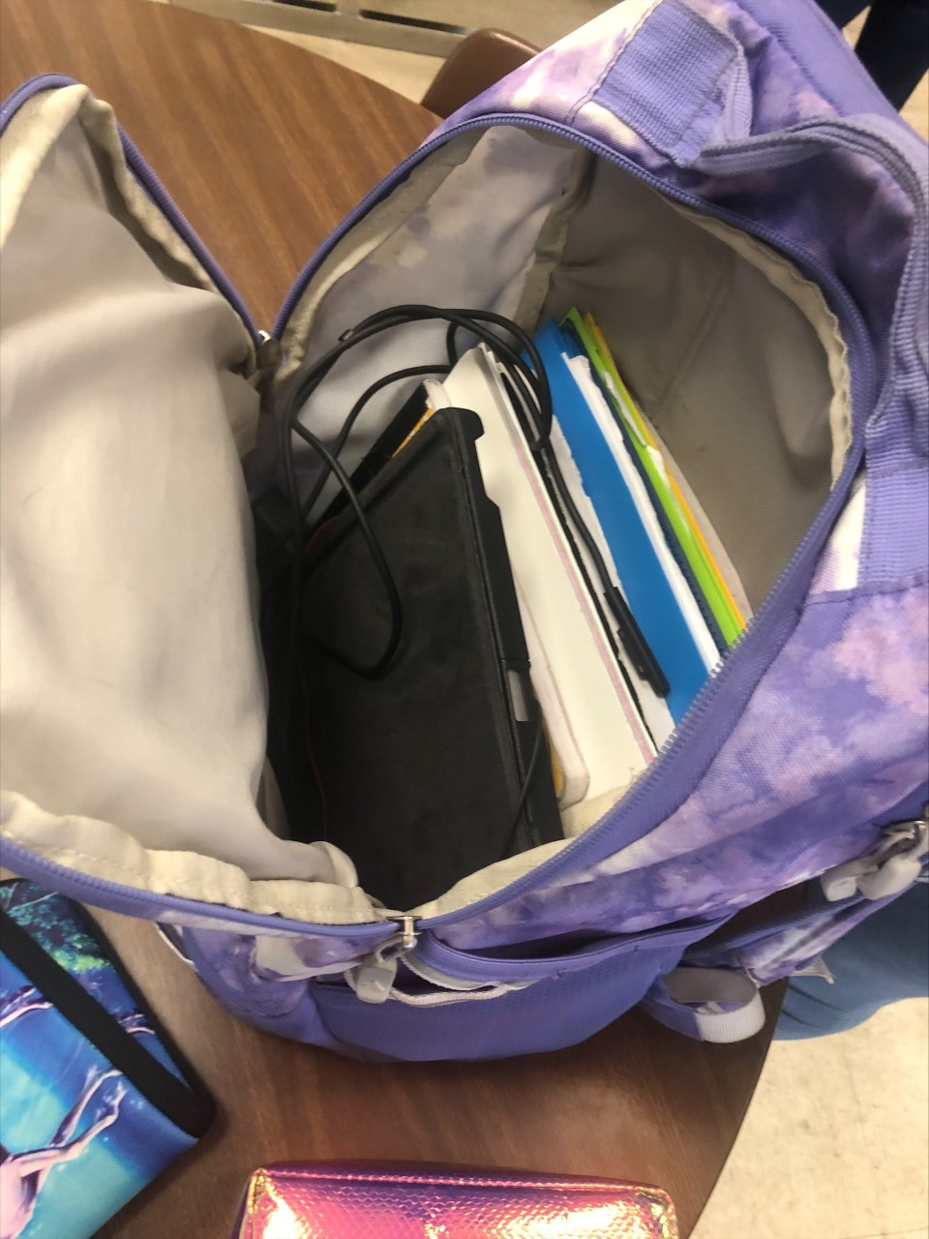
Backpacks

Slide 7
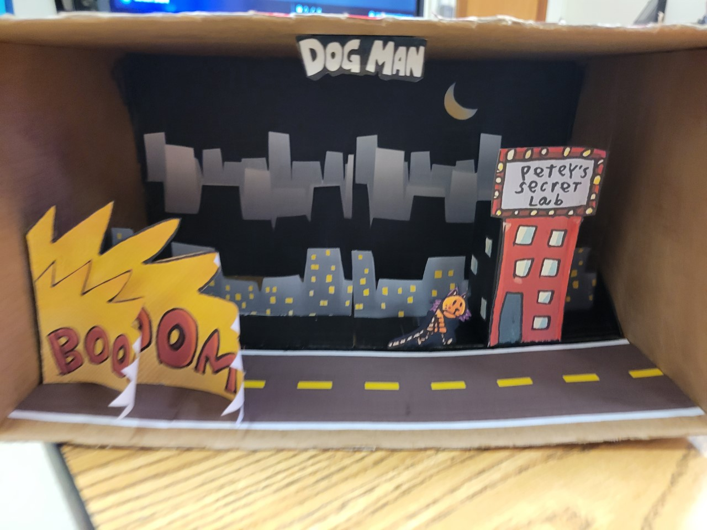
Required Backpack Contents
Math Workbook
Math Journal
Science Workbook
Science Journal
Social Studies Journal
ELA Blue Folder
Device/charger
Art Supplies-Recorder
Library Book

Slide 8
Important Dates
March 5 – Chess Tournament, Math Club, Robotics
March 7-11 - Student Council Spirit Week
March 14-18 - Spring Break
March 21 - April 8 - Fastbridge Testing
March 1 - April 1 - Mastery Connect
March 30/31 – All City Rehearsal
March 31 – All City Concert at 7 pm
Cannon Center
March 2022

Slide 9
Important Dates
April 8 - West TN Festival Chorus
All Day rehearsal with Concert at 5 pm
First Baptist Church Millington, TN
April 15 - No School, Good Friday
April 18-29 - TCAP Testing
April 2022

Slide 10
Important Dates
May (TBD) PTO Sponsored Boosterthon
Tenatively May 3-12 or May 10-20
May 6 - Dare Graduation
May 6 – Student Council Spring Dance, 6:00-8:30
May 12 - Spring Concert
6:00 pm at Crosstown (Tenatively)
May 13 – Recorder Ensemble Adopter/Community pop-up concert
iReady Testing- May 16-27
May 20 - End of the Year Field Trip
May 25 - Graduation rehearsal
Idlewild Presbyterian Church
May 26 – Graduation
Idlewild Presbyterian Church
May 2022

Slide 11
Middle School Entrance Requirements MSSA
Have grades of A’s and B’s, with no more than one C as a semester average, on most recent report card.
Score at or above the 65th percentile on the FastBridge aReading and aMath assessments; score at or above the 65th percentile on the most recent (Spring 2021) TCAP TNReady English Language Arts and TCAP TNReady Mathematics assessments; score at or above the 65th percentile on the spring NWEA MAP Growth Reading and Mathematics assessments; score at or above the 65th percentile on the Total Reading/Reading Composite and Total Mathematics/Mathematics Composite of an acceptable nationally normed achievement test. Acceptable tests must be dated Spring 2019 or later. • Have conduct grades of satisfactory or above.
Have satisfactory attendance (no more than 15 absences and/or tardies to school or to class).

Slide 12
Middle School Entrance Requirements MSSA
Students and parents will be required to sign a Parent Student Agreement stating that they understand the expectations of this program and are committed to maintaining them. Once it is determined that the student meets the minimum requirements, an interview will be scheduled.
Students are required to participate in our Extended Lab activities.
All students will be on an Optional transfer and must meet and maintain the minimum entrance requirements.
To remain in the Optional Program, students must maintain an average of C or above in each subject, each semester, participate in extended day activities and meet the entrance requirements for conduct and attendance.

Slide 13
Middle School Entrance Requirements WSMS
Have A's and B's with no more than one C on the most recent comprehensive report card as a semester average
Have satisfactory conduct
Have satisfactory attendance, including promptness to school and to each class
A total of more than 15 absences and/or tardies is considered unsatisfactory
Test requirements:
Score at or above the 80th percentile on school-based administration of the Illuminate FastBridge aReading and aMath assessments (2021-22) and/or i-Ready Diagnostic Reading and Math assessments (2021-22); or score at or above the 80th percentile on the TCAP Achievement English Language Arts and TCAP Achievement Mathematics assessments; or score at or above the 80th percentile on the Total Reading/Reading Composite and Total Mathematics/Mathematics Composite of an acceptable nationally normed achievement test.

Slide 14
Middle School Entrants Requirements WSMS
Acceptable tests must be administered in person and dated Spring 2021 or later.
To remain in the Optional Program, students must maintain an average of C or above in each subject, each semester, and the entrance requirements for conduct and attendance.
Students who are accepted into the Optional Program at White Station Middle School and who meet renewal requirements will be accepted into the White Station High School Optional Program on a continuation basis.
Final approval is contingent upon review of the student's second-semester/final report card.
White Station Middle School Virtual Walk Through

Slide 15
Middle School Entrance Requirements SMS
Third-Eighth grade applicants must score at or above the 70th percentile on the Fastbridge aReading and aMath assessments; score at or above the 70th percentile on the TCAP Tn Ready English Language Arts and the TCAP TNReady Mathematics assessments; score at or above the 70th percentile on the NWEA MAP Growth Reading and NWEA MAP Growth Mathematics assessments; score at or above the 70th percentile on the Total Reading/Reading Composite and Total Mathematics/Mathematics Composite of an acceptable nationallynormed achievement test. Acceptable tests must be dated Spring 2021 or later.
Second-Eighth grade applicants must have all A’s and B’s with no more than one C as a semester average, satisfactory grades in conduct and satisfactory progress in the non-academic subject areas on the most recent comprehensive report card.
All applicants must have satisfactory attendance, including promptness to school and to each class, with no more than 15 absences, tardies and/or early dismissals.

Slide 16
Middle School Entrance Requirements SMS
To remain in the optional program, a student must maintain an average of C or S in each subject, each semester. All students must maintain the entrance requirements for standards in academic and support subjects, conduct, skills, and behaviors and attendance.
Final approval is contingent upon review of student’s second semester/final report card issued by May 27, 2022.
Snowden Virtual Open House

Slide 17
Middle School Entrance Requirements BMS
Score at or above the 50th percentile on the TCAP TNReady English Language Arts and the TCAP TNReady Mathematics assessments; score at or above the 50th percentile on the Total Reading/Reading Composite and Total Mathematics/Mathematics Composite of the NWEA MAP and/or another acceptable nationally normed achievement test. Acceptable tests must be dated Spring 2017 or later.
• Have satisfactory conduct and attendance (including promptness to school and to each class), with no more than 15 absences and/or tardies.
• To remain in the program, a student must maintain a semester average of C or above, with no D’s or below in all subjects, as well as satisfactory conduct and attendance.
• Students must remain in the required Optional courses for each grade.
• Transportation to the school is the responsibility of the
student’s parents/legal guardians. Final approval is
contingent upon review of the student’s second semester/final report card Issued by June 7, 2022

Slide 18
End of the Year Field Trip
May 20
Discovery Park
More Information coming

Slide 19
Criteria to go on the field trip
Starting February 16 - May 19
Good Conduct Required – E/G/S
Good Attendance – 5 or Less Unexcused Absences

